Slide 1
Tameside
Mental Health Support Team

Slide 2
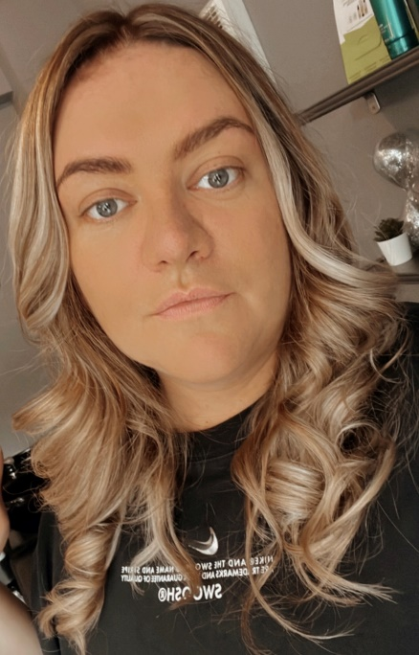
Who I am and what we do ☺
My name is Holly, and I am an Educational Mental Health Practitioner (EMHP) ☺
This means I work with children and young people giving them coping strategies to support their worries, phobias and low mood, and sometimes I work with parents/carers and school staff members focusing on wellbeing!
I spend every Monday morning here at Broadbottom Primary School supporting different young people with their current wellbeing so you might have seen me around!

Slide 3
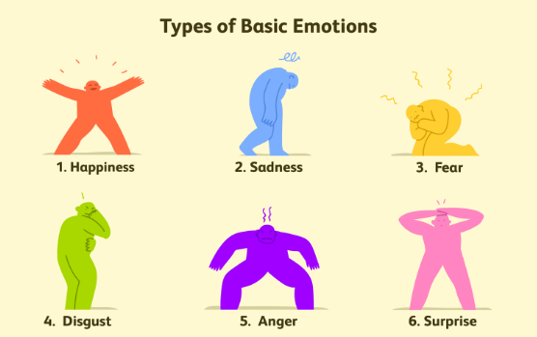
What is Mental Health?
-Our thoughts, feelings, emotions and behaviours.
-It is important like our physical health.
-How we cope with stress and challenges.
Notes:
Ask students to discuss with one another what they think mental health is then feedback.

Slide 4
The Five Ways to Wellbeing
Notes:
Explain that something you would like to MHA to do is promote the five ways to wellbeing. Explain that you are going to look into this in more depth.

Slide 5
Getting support…
Find someone you trust to talk about how you are really feeling
In school, the best person to talk to may be your class teacher or headteacher.
Go to your GP (doctor)
Call helplines/websites:
Notes:
Remind the MHA ambassadors that they must be looking after their own mental health and wellbeing to fulfil their role. Explain that is something you have to do.

