Slide 2
At Broadbottom we aim to:
Develop a positive attitude and growth mind set to mathematics in all pupils, from their earliest days in school
Enable pupils to understand the importance of Mathematics and how it is essential to everyday life, critical to science, technology and engineering, and necessary in most forms of employment.
Develop fluency in the fundamentals of mathematics through varied and frequent practice with complexity increasing over time.
Build skills in problem solving, using fluency knowledge in a variety of different situations.
Develop confidence in Mathematical reasoning, using mathematical language to provide proof and justification.

Slide 3
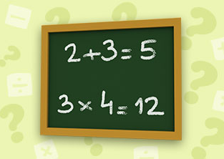
Mathematics is essential to everyday life, critical to science, technology and engineering, and necessary in most forms of employment.

Slide 4
Mathematics covers many areas: Place value, calculations, fractions, measure, geometry and statistics. Skills in these areas are developed to allow children to solve problems.
Enter Text

Slide 5
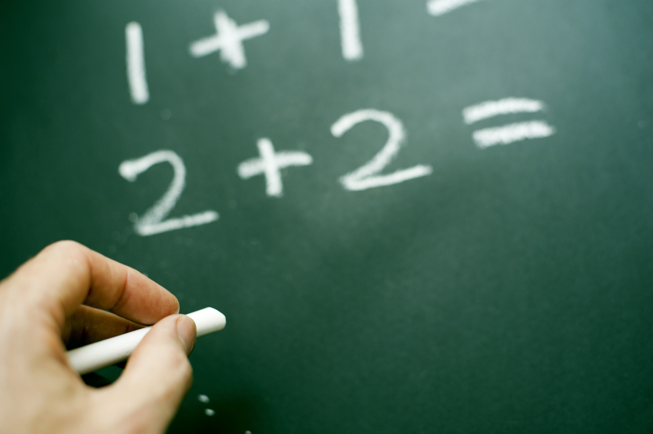
Fluency skills are taught through discrete lessons allowing children to have the skills to tackle problems in a range of areas.
Enter Text

Slide 6
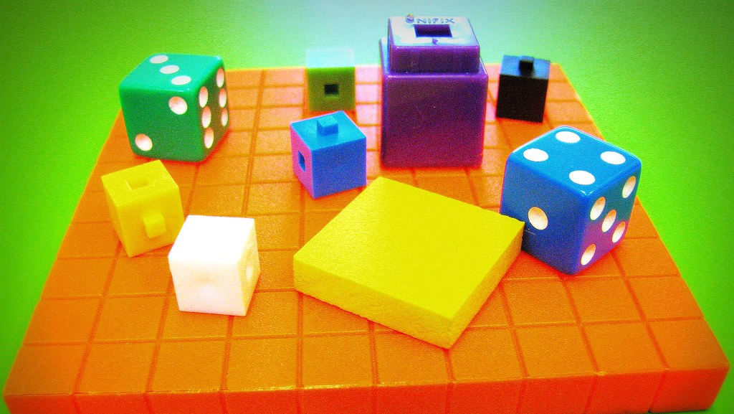
Children’s mathematical skills are developed through a Concrete, Pictorial, Abstract approach. This approach enables links to be made.

Slide 7
Mathematics builds confidence in reasoning. Pupils are able to notice relationships, make generalisations and use mathematical language to explain their thoughts.

Slide 9
Books
Learning walks
quizzes
Pupil voice
Moderation

