Slide 2
At Broadbottom we aim to:
‘Our vision in science is to encourage curiosity in children so that they ask questions that fuel navigators, explorers and adventurers in the universe we live in.’
Providing a stimulating, engaging and challenging learning environment.
Encourage pupils to develop and use a range of scientific skills including:
Processes and Changes
Methods
Observing and Recording
Scientific Vocabulary
Uses and Implications
Cross-Curricular Links (STEM)

Slide 3
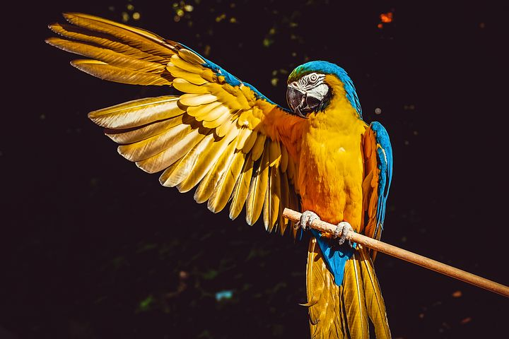
Science nurtures pupils’ natural curiosity and helps develop inquiring minds.

Slide 4
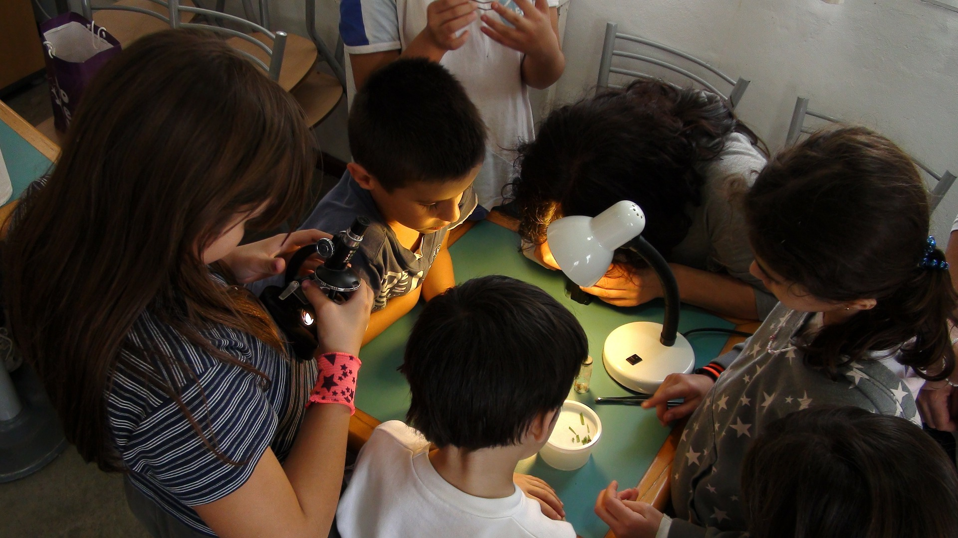
Science encourages pupils to ask ‘how’ and ‘why’ questions, with the aim of finding out the answers.

Slide 5
Science motivates pupils
to explore the world
around them and to
change it for the better.

Slide 6
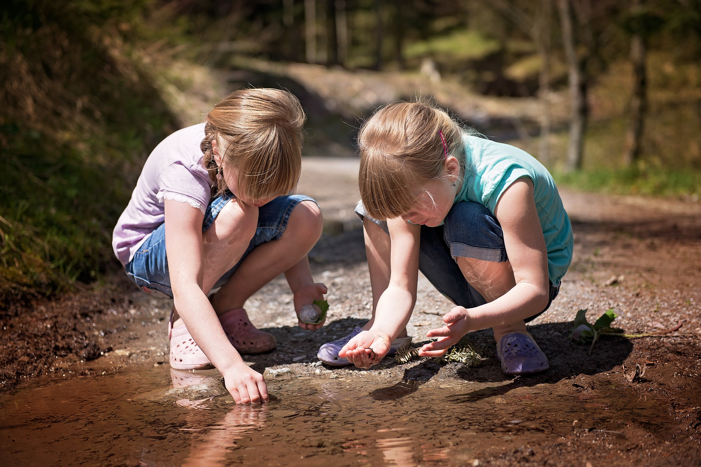
Practical experiments, investigations and making hypothoses in science teach pupils the importance of accuracy and problem-solving.

Slide 7
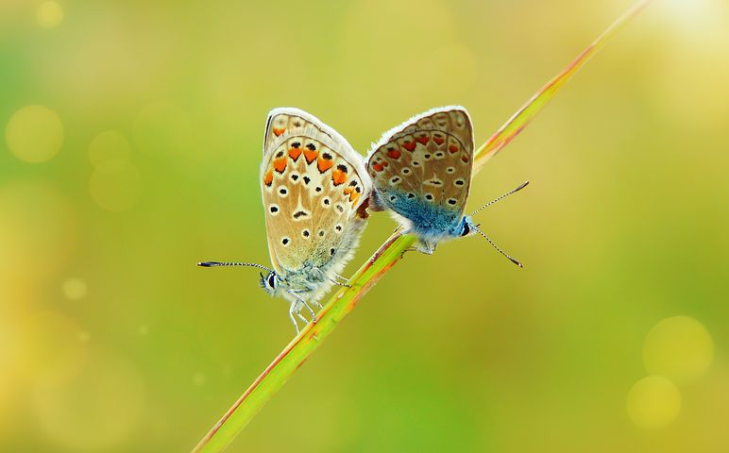
Science teaching opens
up new ways of thinking
which complement and /
or challenge established
ideas and knowledge.

Slide 8
Books
Learning walks
Kahoot quizzes
Time machine
Pupil voice
Moderation

